Slide 1


DATA SCIENCE EL-334 BSIT
LECTURE # 06
Scikit Learn
A Machine Learning Library
by
Safoora Qurban

Slide 2
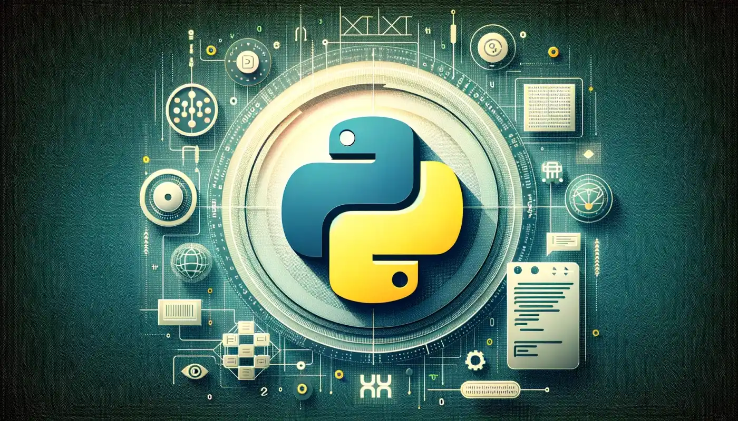
Scikit Learn : A Machine Learning Library

Slide 3

What is scikit-learn?
scikit-learn is one of the most widely used Python libraries for machine learning.
Built on top of NumPy, SciPy, and Matplotlib, it provides simple and efficient tools for a range of machine learning tasks such as classification, regression, clustering, dimensionality reduction, and preprocessing.
It is popular for its simplicity, consistency, and comprehensive documentation, making it a preferred choice for both beginners and professionals in data science.

Slide 4
scikit-learn Features
Machine Learning Models: Offers implementations for both supervised and unsupervised learning algorithms like Linear Regression, Support Vector Machines (SVM), Decision Trees, K-Means Clustering, and Principal Component Analysis (PCA).
Preprocessing: Tools for scaling, encoding, imputing missing values, and feature selection.
Model Evaluation: Includes metrics and tools for model evaluation such as accuracy, precision, recall, F1-score, and R-squared.
Hyperparameter Tuning: Supports hyperparameter optimization through grid search and random search methods.
Pipelines: Automates workflows, combining preprocessing and model training into a single object.

Slide 5
Applications in Data Science
• Predictive modeling (e.g., predicting housing prices or customer churn).
• Exploratory data analysis (EDA) through clustering and dimensionality
reduction.
• Automating machine learning workflows using pipelines.
• Evaluating model performance with statistical metrics.

Slide 6
Key Design Principles
Simplicity and Consistency
scikit-learn uses a unified API design across all its modules, ensuring that the syntax for different tasks (like training a model or preprocessing data) remains consistent.
Example: The .fit() method is used to train models, while .predict() is used for making predictions, regardless of the algorithm.

Slide 7
Key Design Principles
2. Reusability Through Pipeline
The library allows combining multiple steps (e.g., scaling, feature selection, model training) into a single pipeline using the Pipeline object.
o This approach promotes cleaner code and ensures consistent application of preprocessing steps during training and testing.
o Example:
from sklearn.pipeline import Pipeline
from sklearn.preprocessing import StandardScaler
from sklearn.linear_model import LogisticRegression
pipeline = Pipeline([
('scaler', StandardScaler()),
('classifier', LogisticRegression())
])
pipeline.fit(X_train, y_train)
Notes:
A pipeline in scikit-learn is a tool for automating machine learning workflows. It combines multiple steps, such as data preprocessing, feature transformation, and model training, into a single object.

Slide 8
Key Design Principles
3. Integration with Other Python Libraries:
NumPy: For numerical operations and array manipulation.
SciPy: For advanced scientific computations, such as sparse matrix support.
Pandas: For handling tabular data and feature engineering.
Matplotlib: For visualizations like confusion matrices and ROC curves.

Slide 9
Installation and Setup
3. Integration with Other Python Libraries:
You can install scikit-learn easily using package managers like pip or conda.
Using pip:
pip install scikit-learn
Using conda:
conda install -c conda-forge scikit-learn

